Slide 1
Power Bi
i. Format functions on date extractions ii. Handling sorting with dates on calendar month and day names iii. Introduction to conditional statements and syntax of the IF statement iv. If statement for deriving metro flag v. If statement to derive weekend and weekday flags vi. If statement to derive the profit tag

Slide 2
Format functions on date extractions
Order year= FORMAT(Orders[Order Date],"yy")
Order qtr= = FORMAT(Orders[Order Date],"q")
Order month desc= FORMAT(Orders[Order Date],"m")
Order month desc = FORMAT(Orders[Order Date],"mm")
Order month desc = FORMAT(Orders[Order Date],"mmm")
Order month desc = FORMAT(Orders[Order Date],"mmmm")
Order day desc = FORMAT(Orders[Order Date],"d")
Order day desc = FORMAT(Orders[Order Date],"dd")
Order day desc = FORMAT(Orders[Order Date],"ddd")
Order day desc = FORMAT(Orders[Order Date],"dddd")
Order qtr desc = "Q-" & FORMAT(Orders[Order Date],"q")

Slide 3
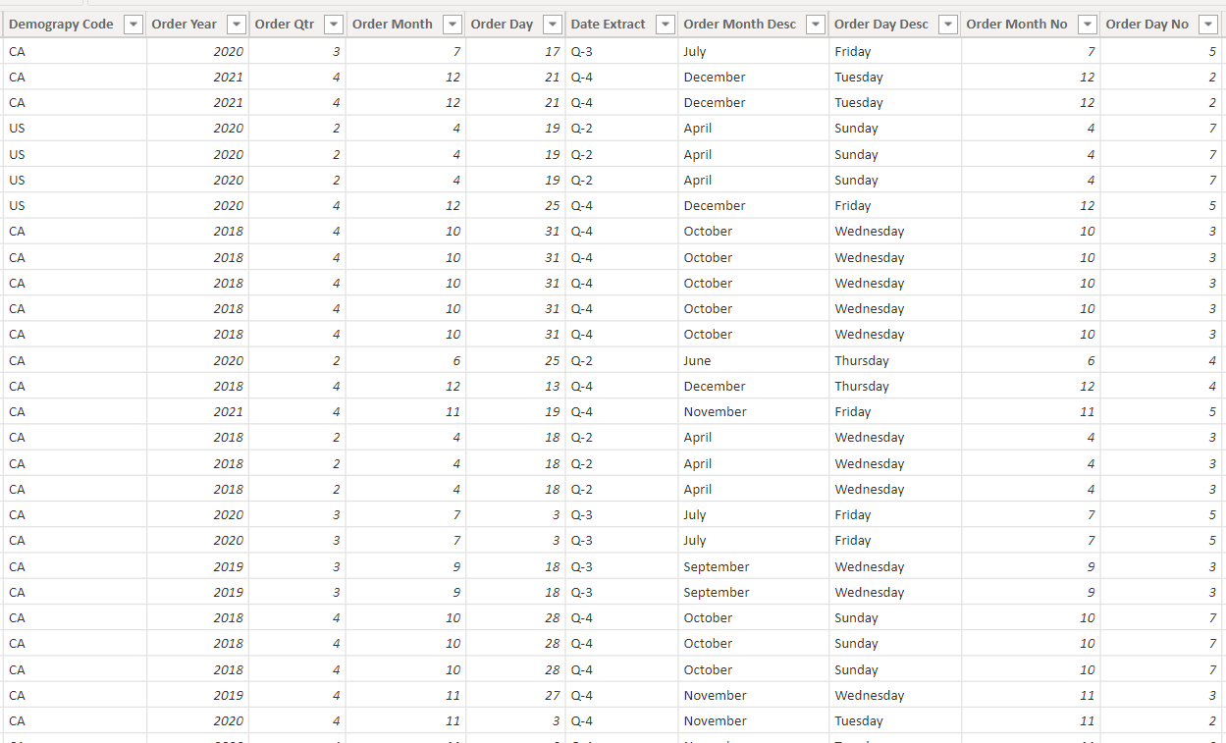
Format functions on date extractions

Slide 4
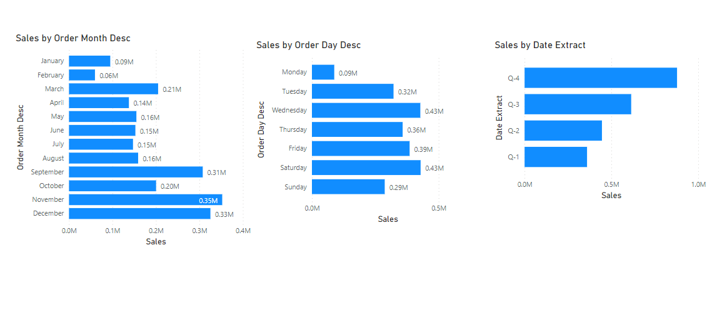
Format functions on date extractions

Slide 5
. Handling sorting with dates on calendar month and day names
Order Day No = WEEKDAY(Orders[Order Date],2)

Slide 6
Introduction to conditional statements and syntax of the IF statement
Conditional Statements:
IF
SWITCH
IF(Condition,op when true, op when false)

Slide 7
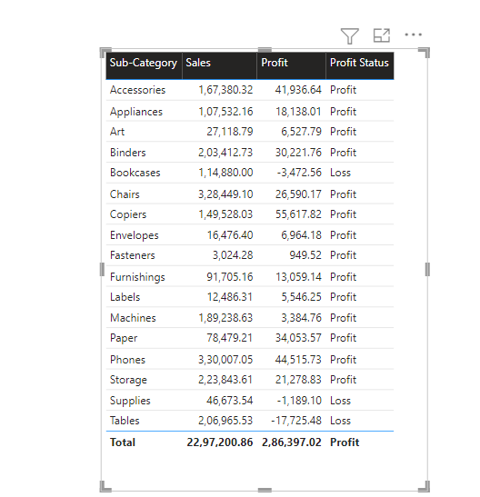
If statement to derive the profit tag
Profit Status = if(SUM(Orders[Profit]) >= 0 , "Profit", "Loss")

Slide 8
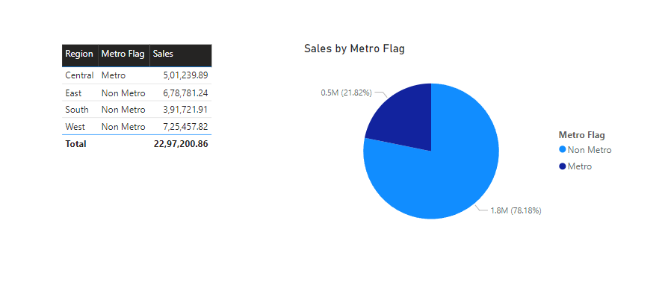
If statement for deriving metro flag
Metro Flag = IF(Orders[Region] = "Central","Metro","Non Metro“)
Metro Flag_ = if(orders[Region] = “Central”,”Metro1”,if(orders[Region] = “East”,”Metro2”, if(orders[Region] = “South”,”Metro3”,”Non metro”)))

Slide 9
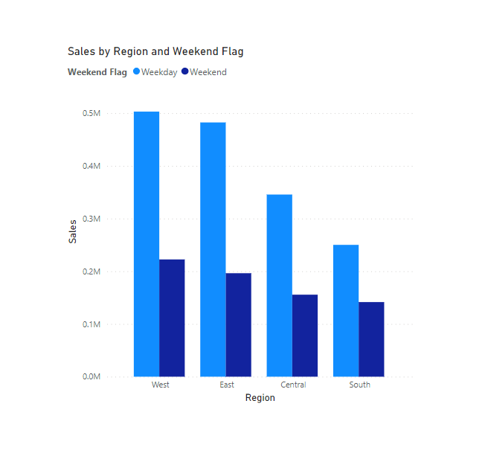
If statement to derive weekend and weekday flags
Weekend Flag = if(FORMAT(Orders[Order Date],"ddd") = "Sun" || FORMAT(Orders[Order Date],"ddd") = "Sat", "Weekend", "Weekday")
Weekend Flag = if(FORMAT(Orders[Order Date],"ddd") in {"Sun","Sat"} , "Weekend", "Weekday")

Slide 10
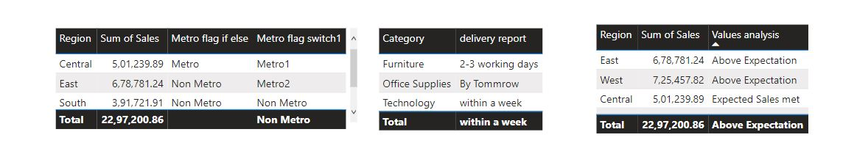
Switch
Metro flag switch1 = SWITCH(SELECTEDVALUE(orders[region]),"Central","Metro1","East","Metro2","West","Metro3","Non Metro")
delivery report = SWITCH(SELECTEDVALUE(Orders[Category]),"Furniture","2-3 working days","Office Supplies","By Tommrow","within a week")
Values analysis = switch(TRUE(),Sum(orders[sales])>=600000,"Above Expectation",sum(Orders[Sales]) >= 500000,"Expected Sales met",sum(Orders[Sales]) >= 400000,"Average","low")

